Slide 1


Slide 2
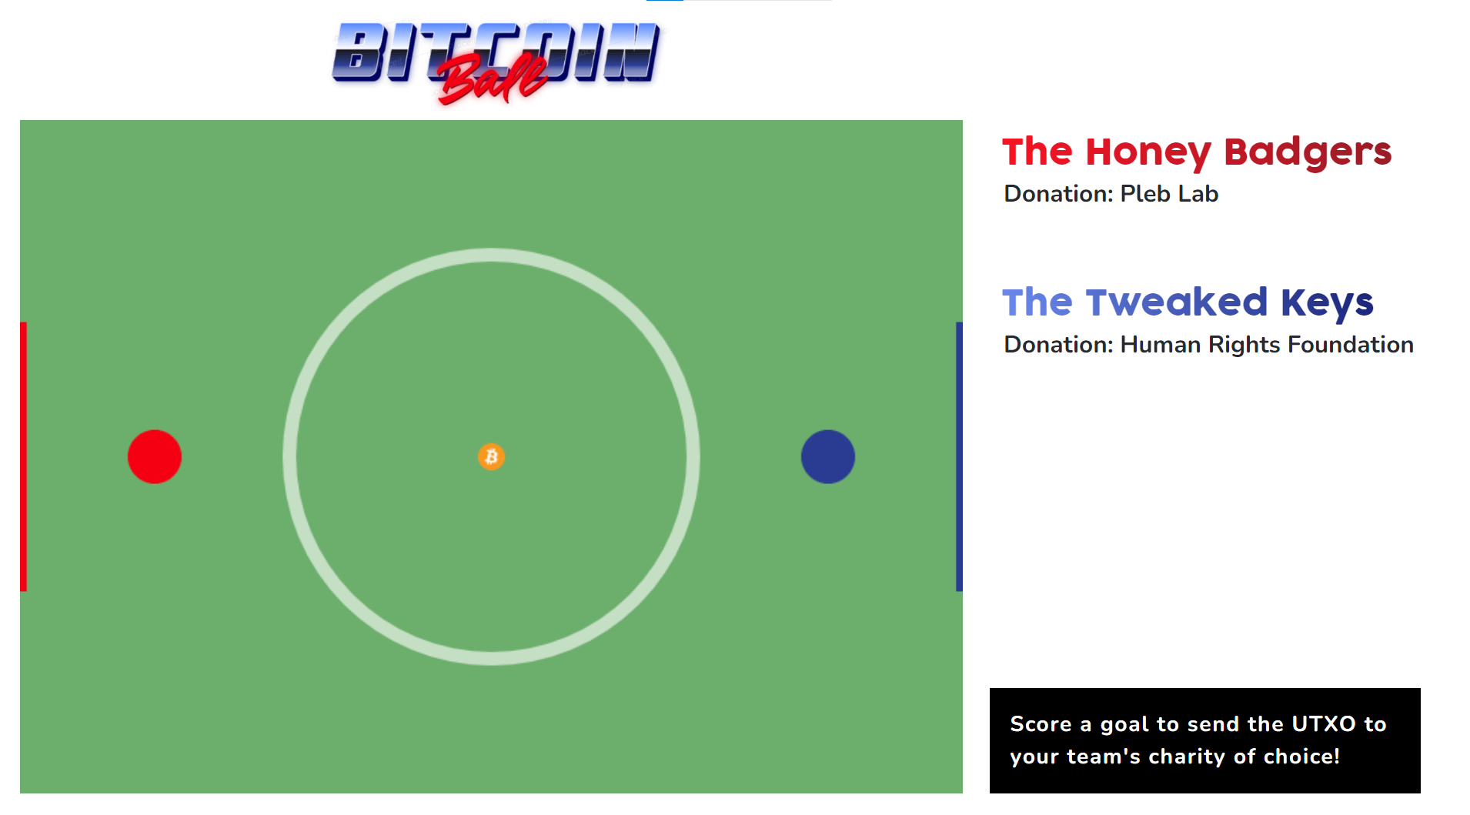
Notes:
We are going to play a bitcoin video game, first let's talk about what the game will do
- I became an author of bip125

Slide 3
We're going to play a game.
But first, let's learn what the game is doing.

Slide 4
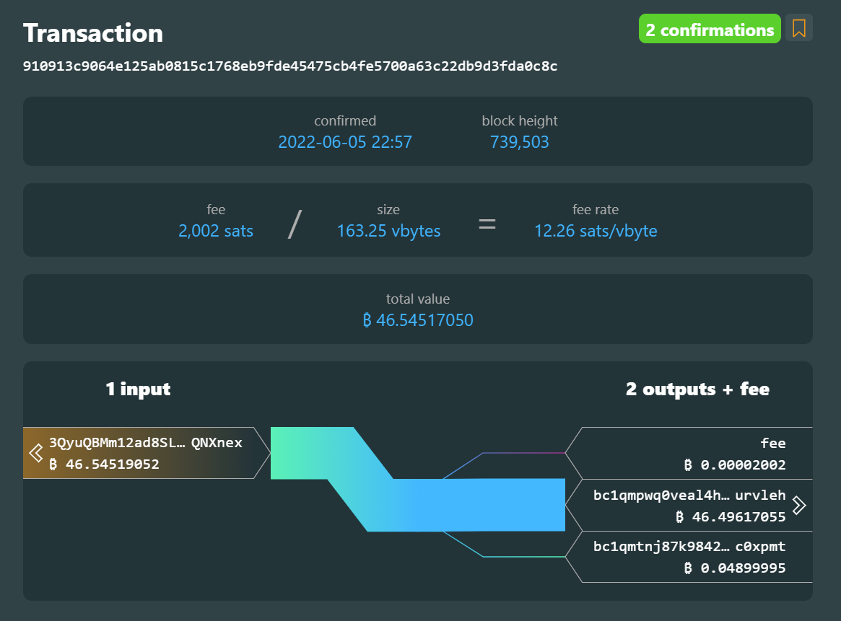
Let's look inside a transaction...

Slide 5
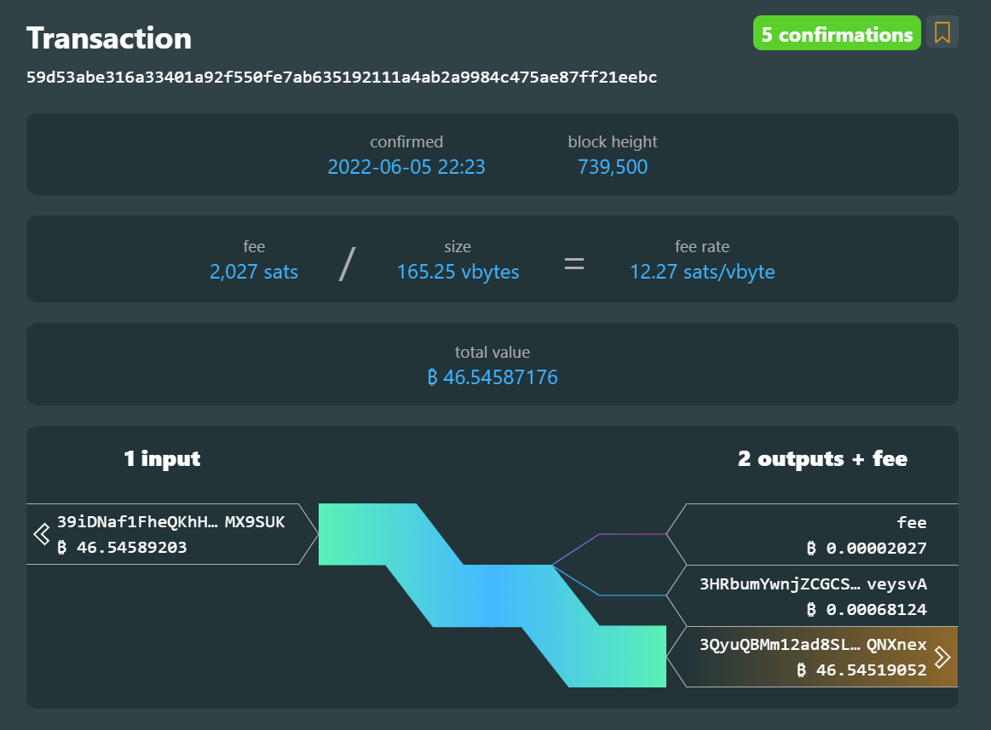
Transactions spend from each other :D

Slide 6
RBF (Replace by Fee)
Notes:
What BIP introduced RBF to bitcoin? Answer: BIP 125

Slide 7
nSequence:
Must be less than 0xfffffffe to opt-in to RBF
Notes:
Question: what is the minimum by which an RBF transaction must increase its fee?
Answer: it's the minimum relay fee for the transaction, currently at 1 sat/ vbyte

Slide 8
CPFP (Child Pays for Parent)

Slide 9
Package Relay (thanks Gloria!)

Slide 10
Okay, let's play the game now!
Let's split up into two teams and pick your team names!

